Slide 1
E-Commerce Website using Node Js and React

Slide 2
Hello! G-29 2045_Gaurav purohit && 2119_Parth Srivastava
I PARTH SRIVASTAVA
Come here to present our project workflow in the form of PPT.
Services used :- Mailgun,JWT,Paypal payment gateway and mongoDB Compass

Slide 3
title
Here you have a list of items
Functionality of our project
Screenshots of Screens which we have created in our project

Slide 4
Functionality
Security Features
.
Features
User-Friendly
Mobile-Friendly Website
Advanced Payment Options
Detailed Shipping Information

Slide 5
Points to Notice :
User-Friendly
The objective is to help shoppers get to what they want faster and without running into unnecessary complexity that can clog up the path to purchase.
Mobile-Friendly Website
With a responsive website, content intuitively adapts to whatever device is accessing it to provide the most user-friendly experience.
Detailed Shipping Information
It’s also helpful to include delivery time and options for faster delivery.

Slide 6
Admin diagram :
Admin
Manage Products
Manage User/Sellers
Can add product
view/delete or edit
Can add seller
view/delete or edit

Slide 7
UseR diagram
user
Can search Product
Can Buy Product
By P_name
By Category_name
To cart
Can purchase product

Slide 8
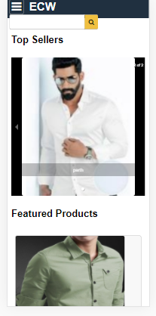

Mobile View of our Project

Slide 9
Screenshots

Slide 10
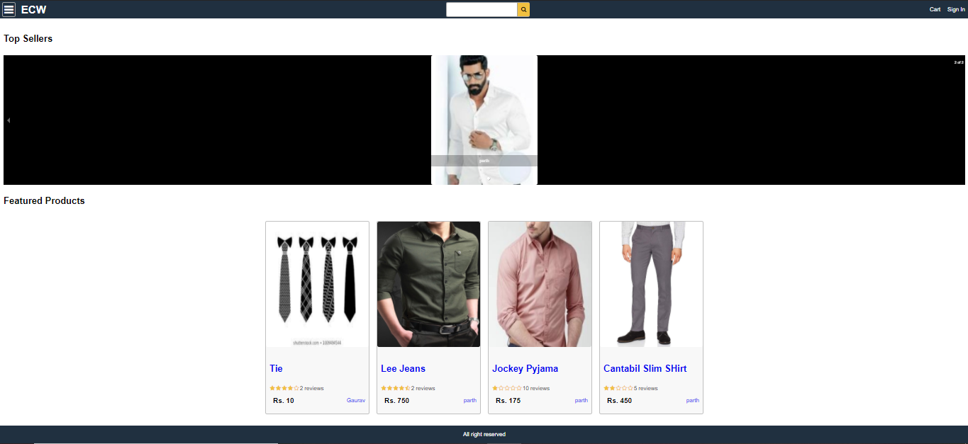
HomeScreen

Slide 11
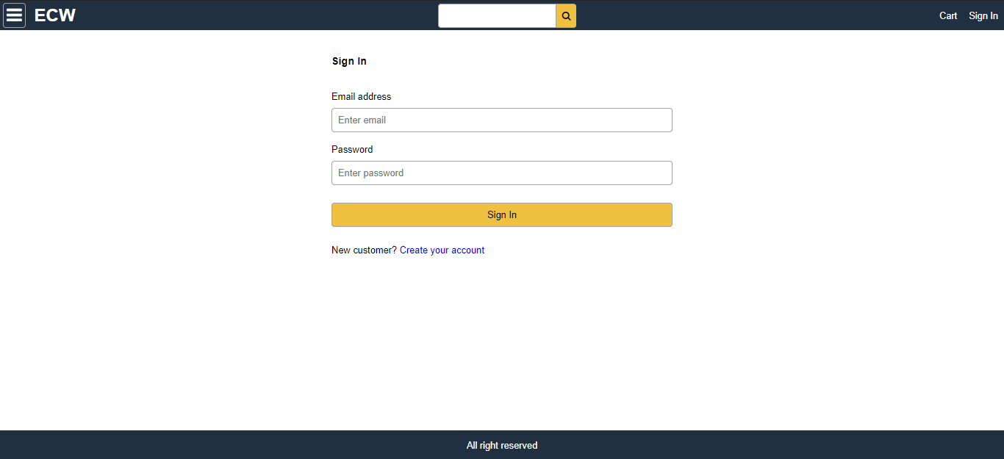
LoginScreen

Slide 12
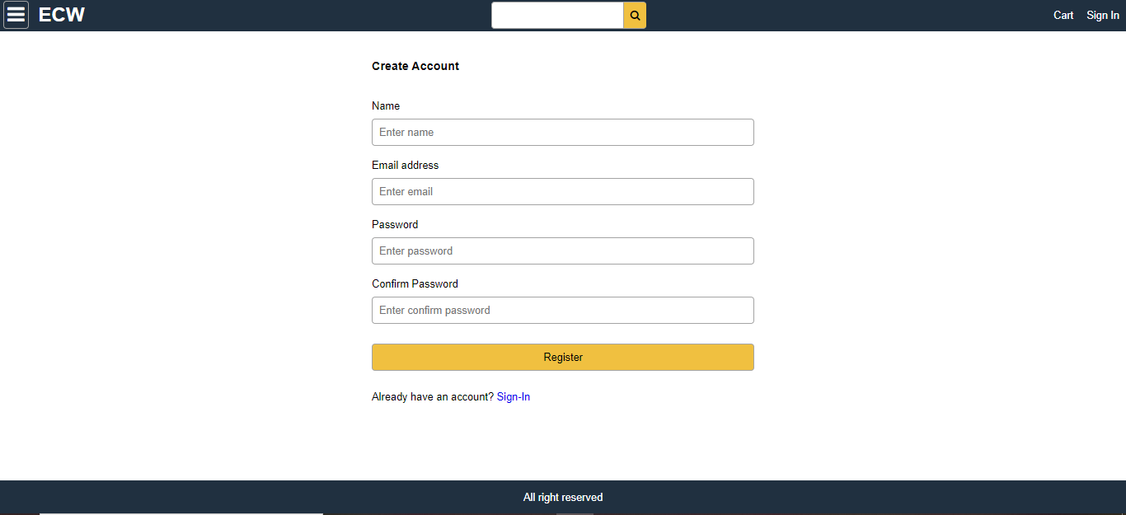
Create Account Screen

Slide 13
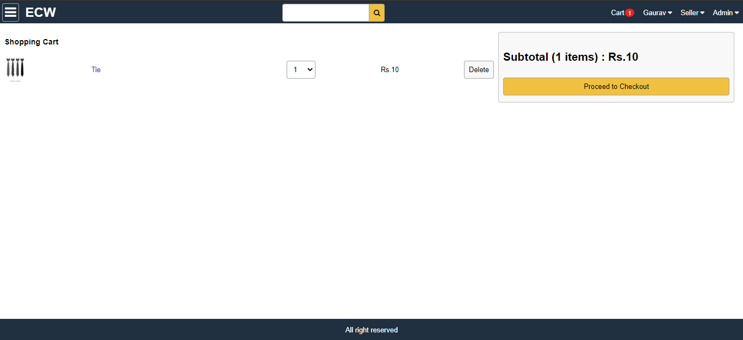
Cart Screen

Slide 14
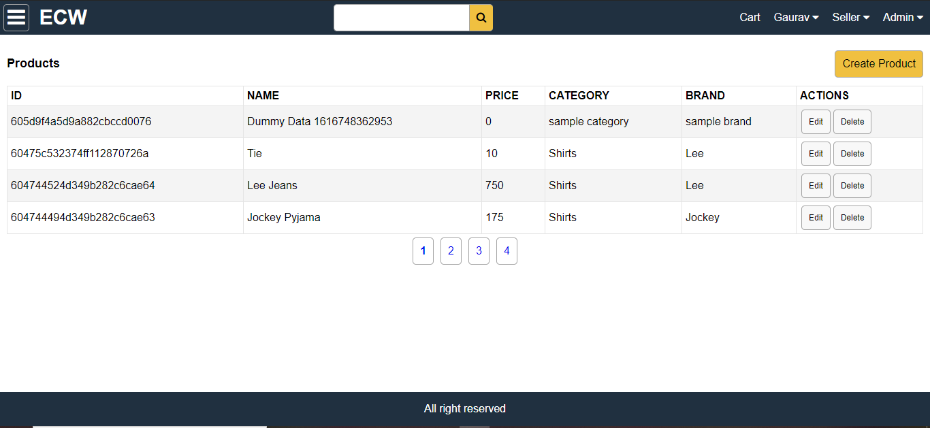
Admin Product List Screen

Slide 15
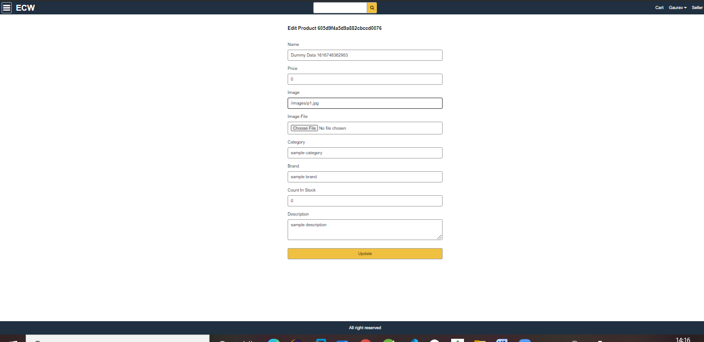
Create Product Screen

Slide 16
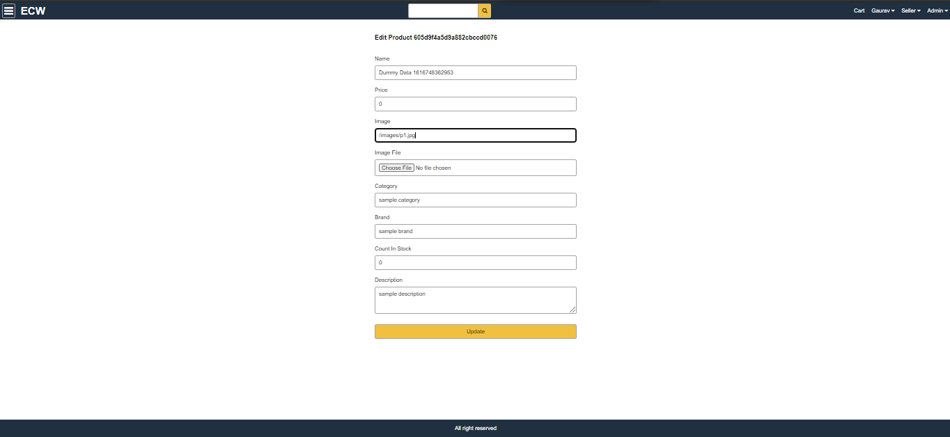
Edit Product

Slide 17
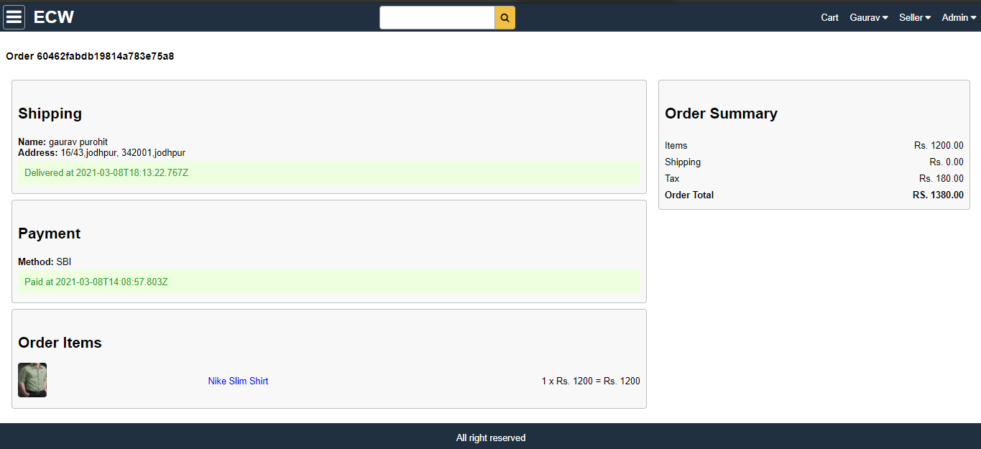
Order Details

Slide 18
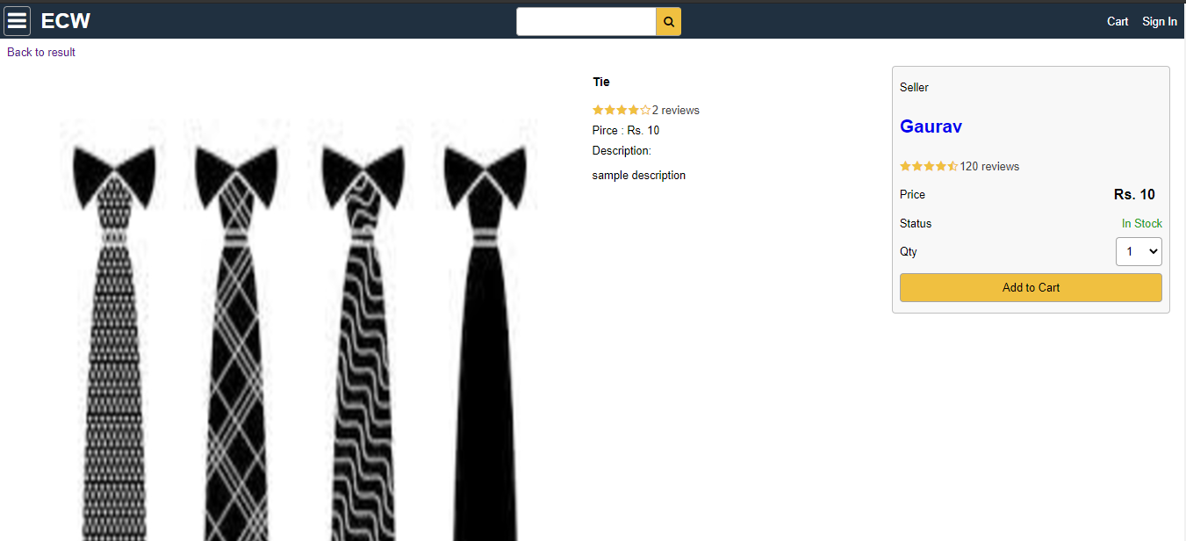
Product screen

Slide 19
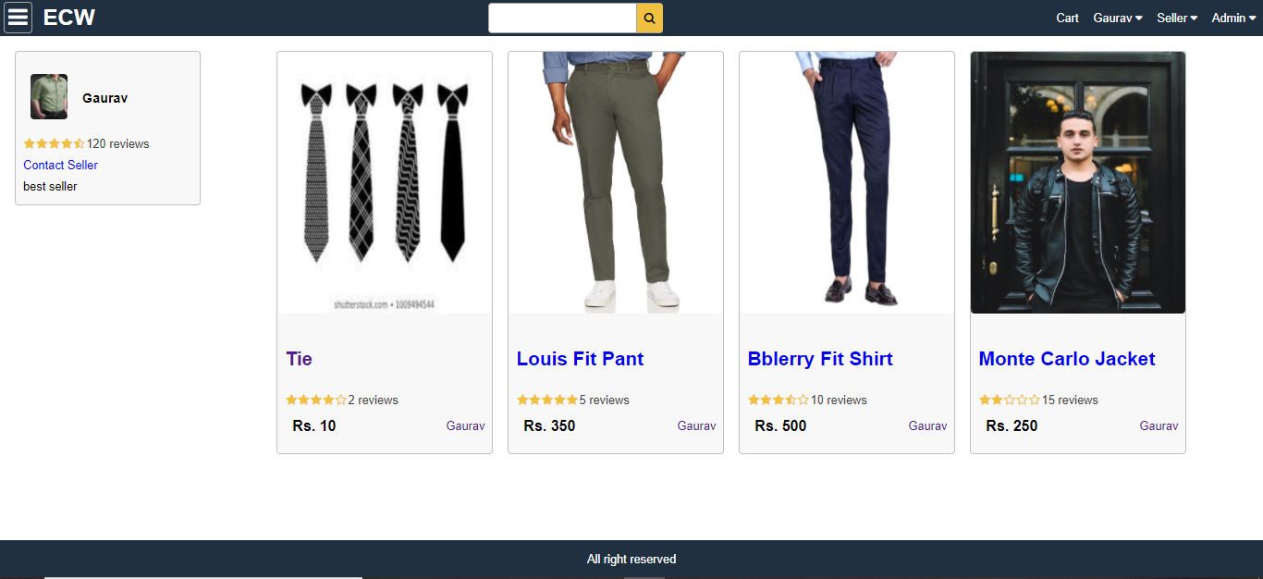
Seller Screen

Slide 20
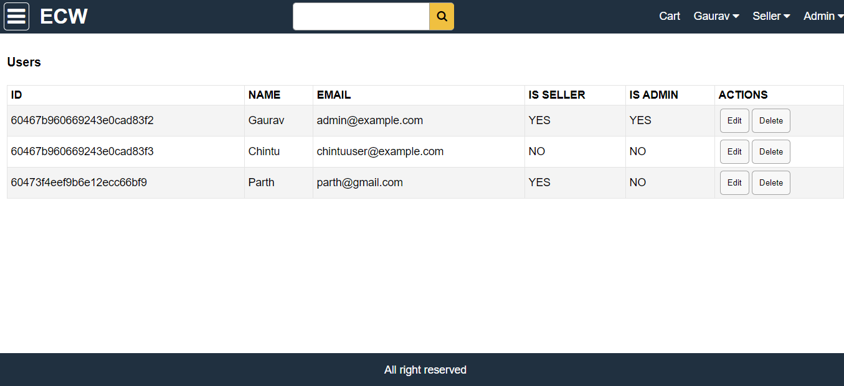
User List

Slide 21
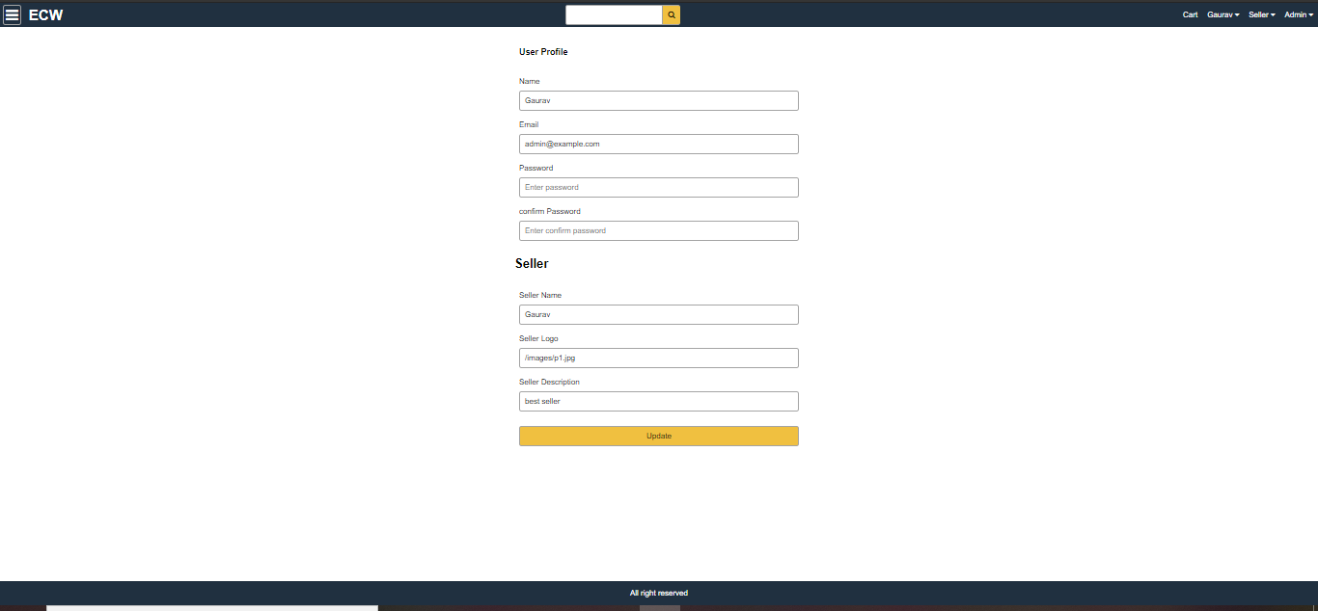
User//Seller Profile

Slide 22
Conclusion :- E-Commerce Website puts forth the actual working of a local shop. Administration, management, payment calculation, seller management, user management, product mangament etc. User can access services and functionalities from the website anywhere and anytime for their own comfort.

